Slide 1
  本讲内容
  Frequent Sub-Graph Pattern

Slide 2
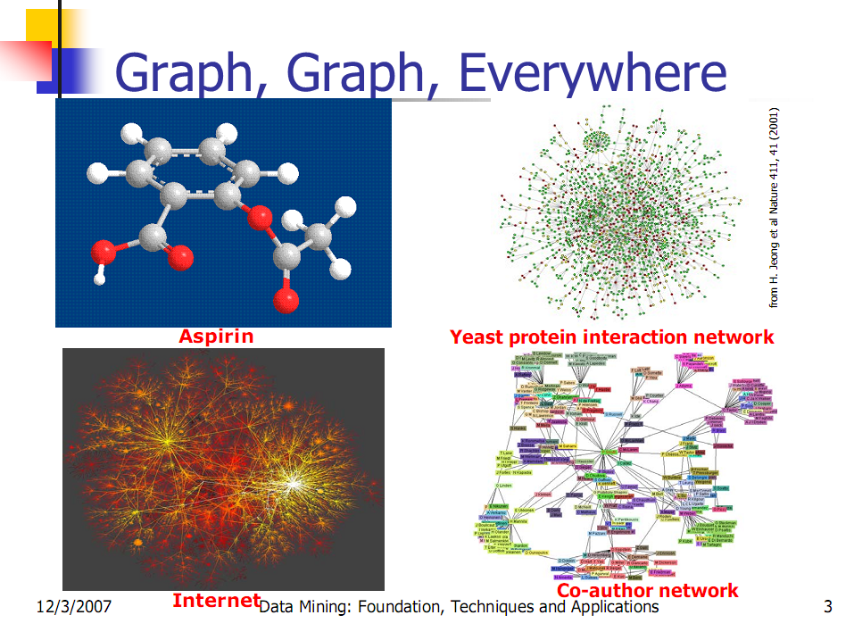

Slide 3
Graph Mining
Graphs are ubiquitous
  Web databases, XML databases
  Cheminformatics (chemical compound)
  Bioinformactics (protein structure, pathway)
  Workflow analysis
  Social network analysis
Graph is a general model
  Trees, lattices, sequences, and items are degenerated graphs
  Graph algorithms: many have high complexity
Diversity of graphs
  Directed vs. undirected, labeled vs. unlabeled (edges and vertices), angles/geometry, weighted edges

Slide 4
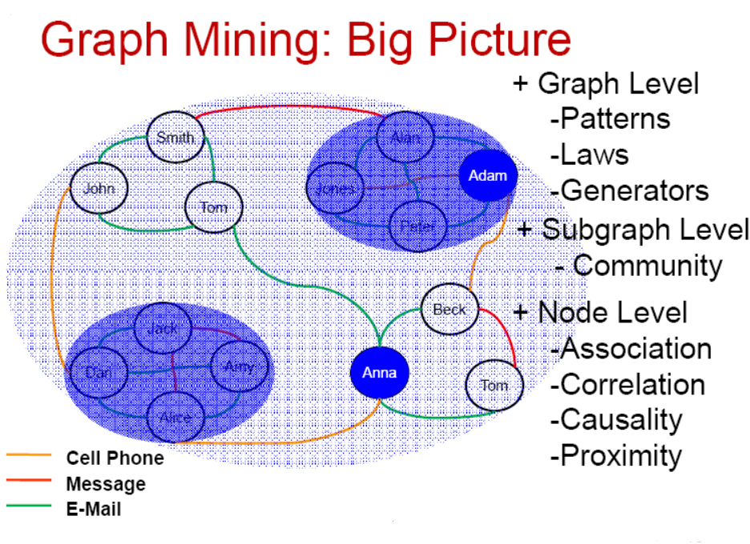
- Frequent Subgraph

Slide 5
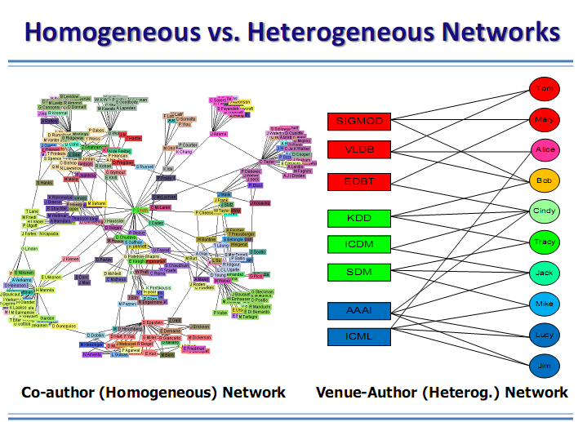

Slide 6
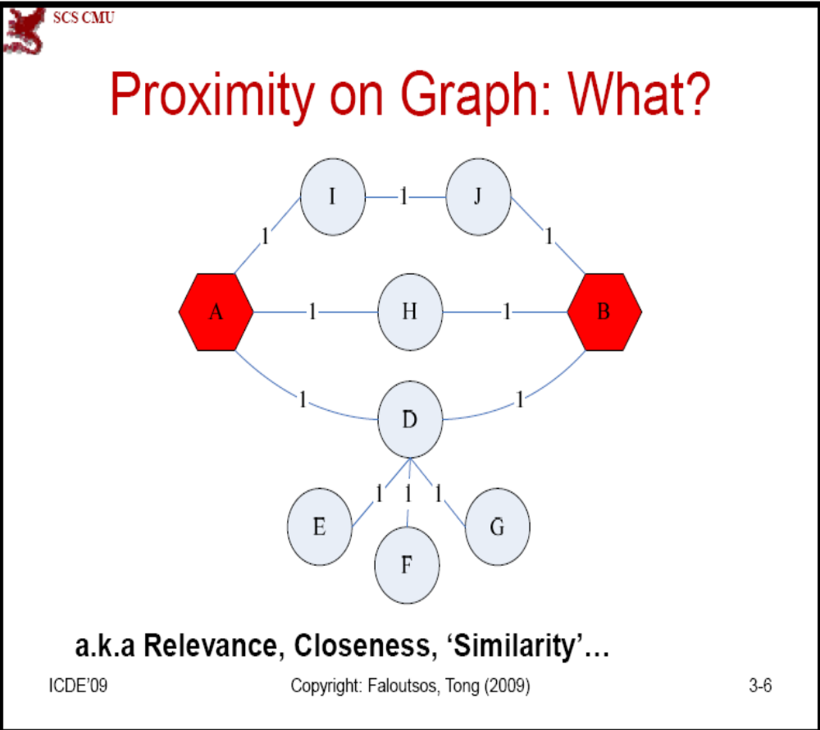

Slide 7
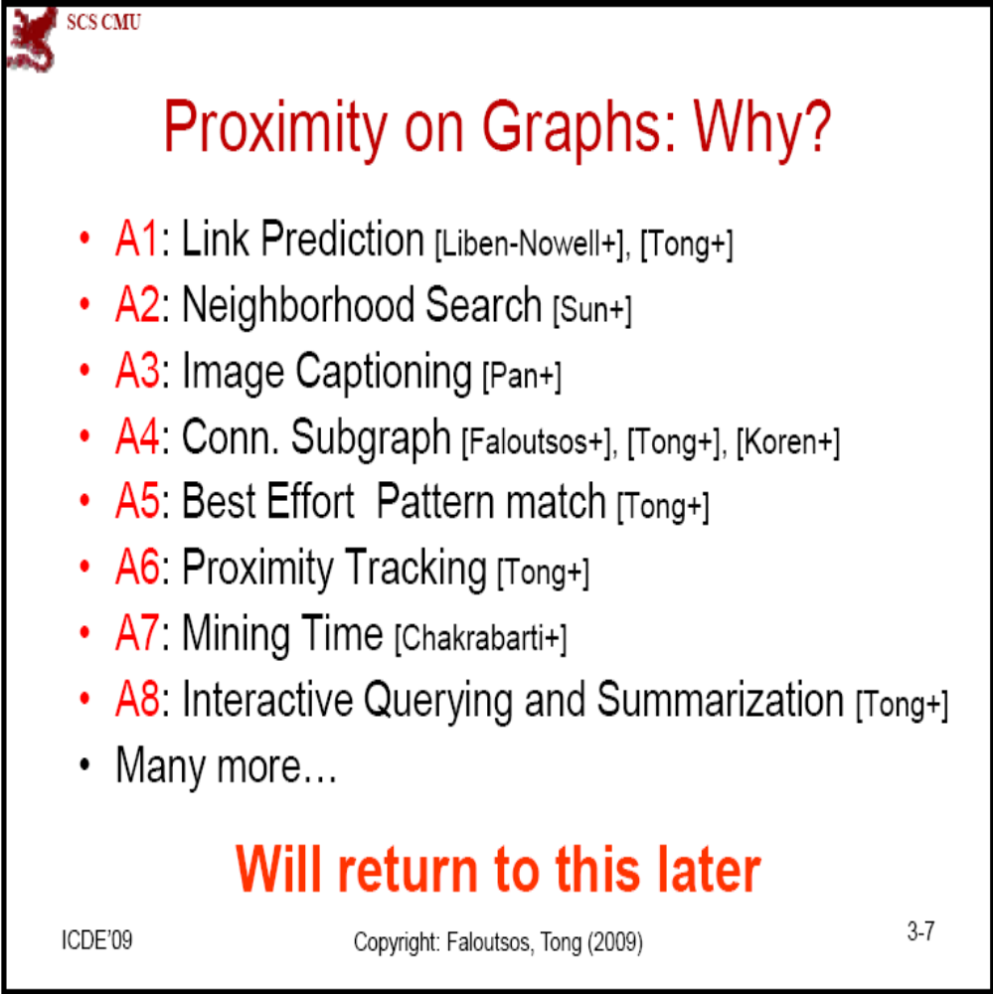

Slide 8
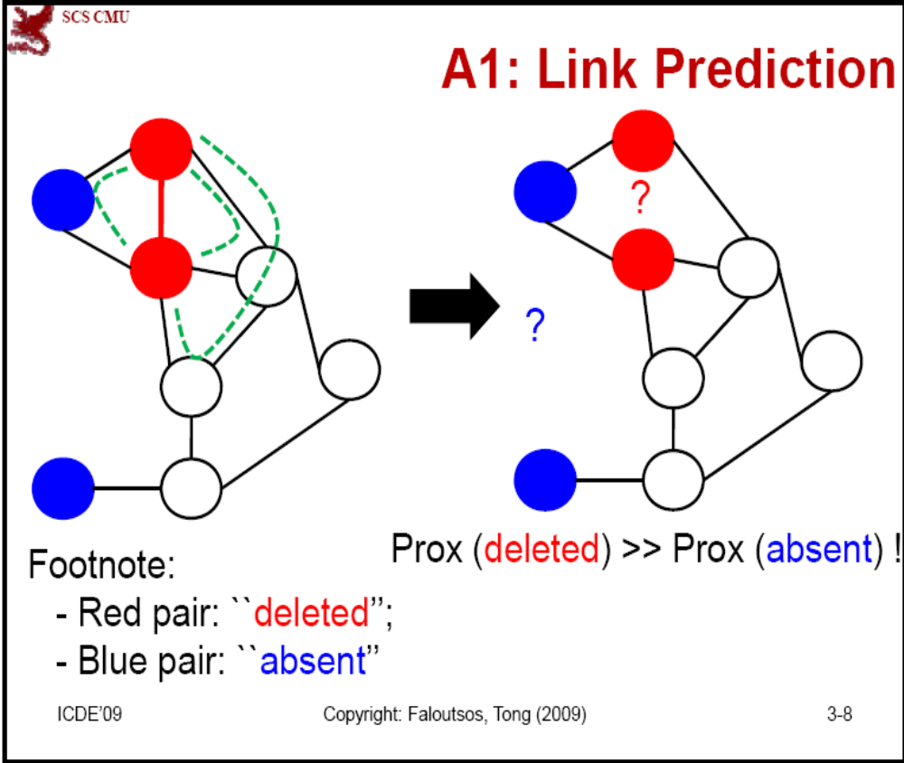

Slide 9
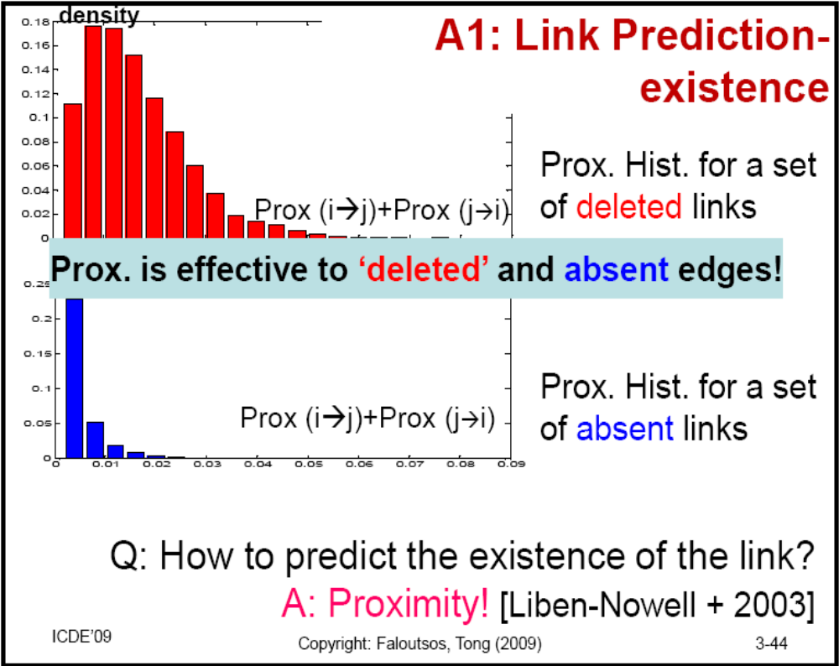

Slide 10
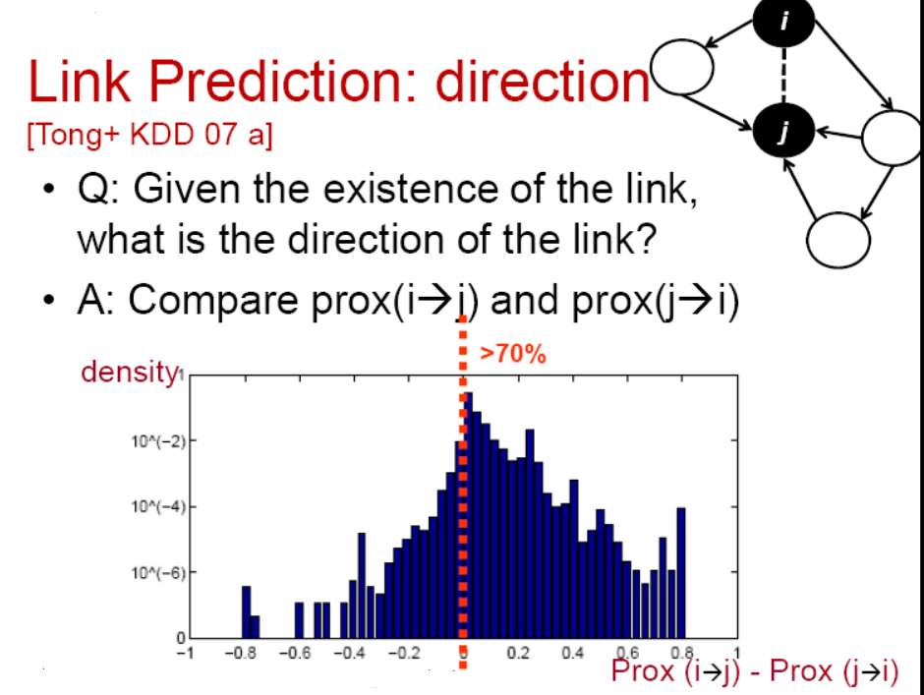

Slide 11
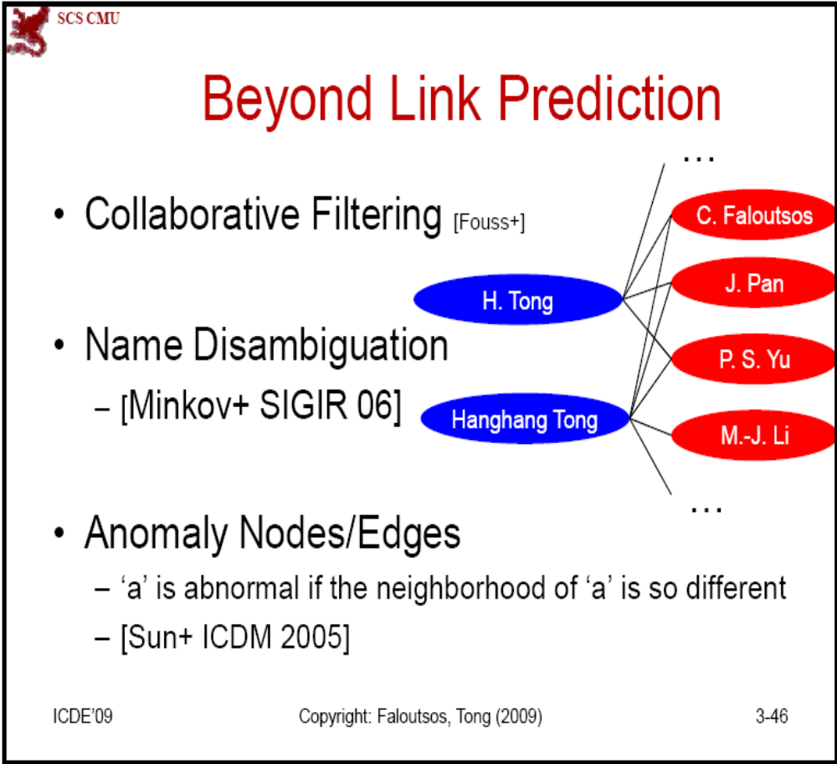

Slide 12
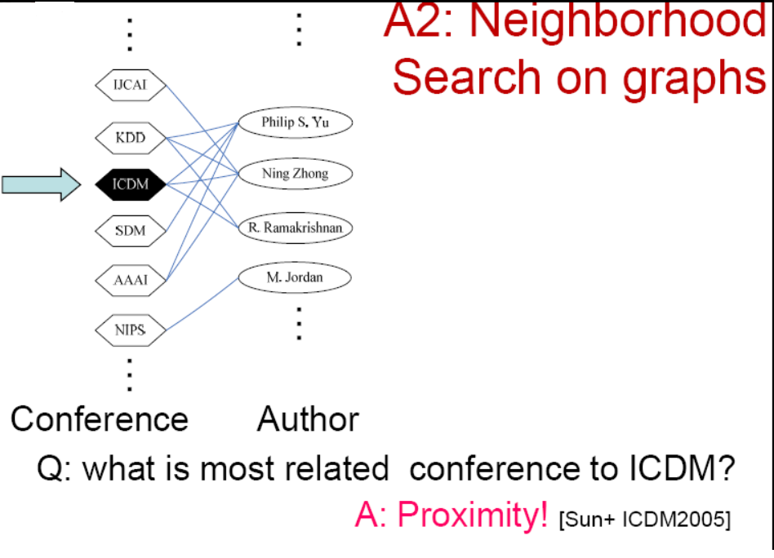

Slide 13
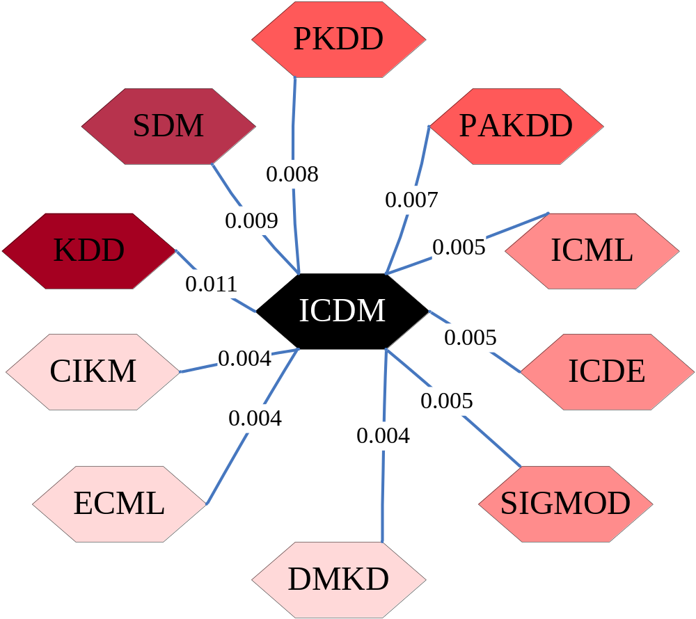
NF: example

Slide 14



Automatic Image Caption
Q
…
{
}
{
}
Sea
Sun
Sky
Wave
Cat
Forest
Grass
Tiger
?
A: RWR!
[Pan KDD2004]
{?, ?, ?,}

Slide 15











Region
Image
Test Image
Sea
Sun
Sky
Wave
Cat
Forest
Tiger
Grass
Keyword

Slide 16
Region
Image
Test Image
{Grass, Forest, Cat, Tiger}
Sea
Sun
Sky
Wave
Cat
Forest
Tiger
Grass
Keyword

Slide 17
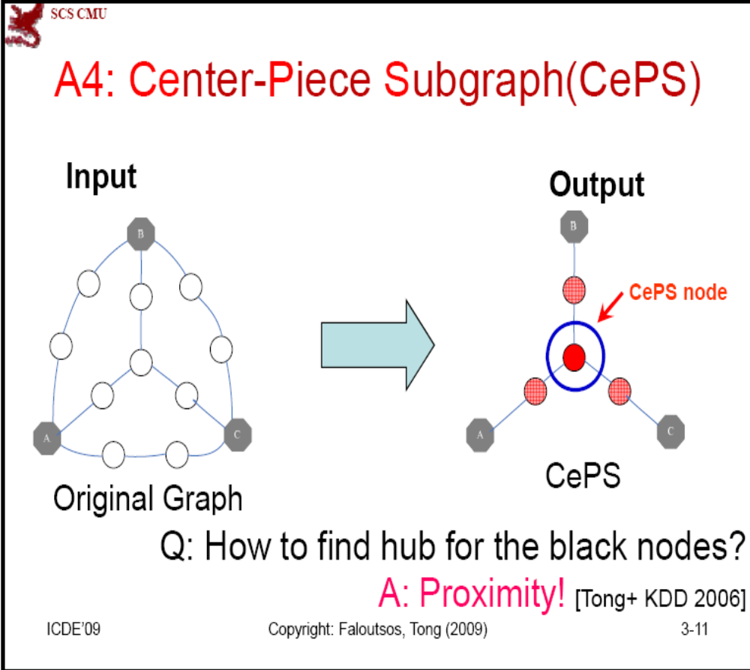

Slide 18
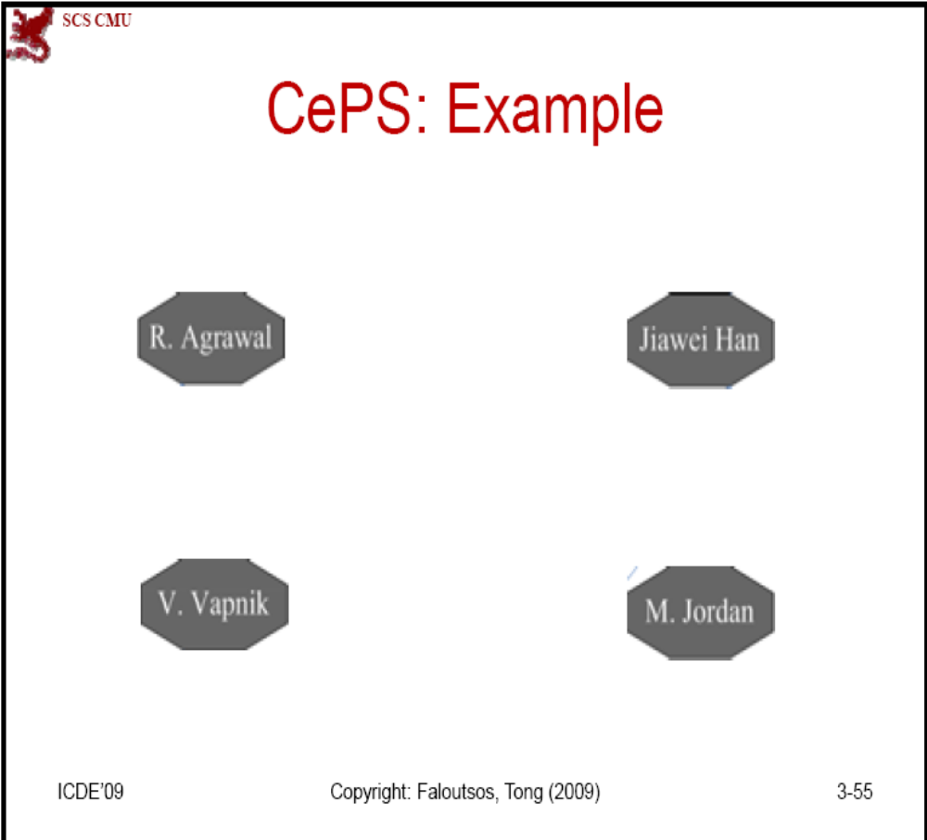

Slide 19
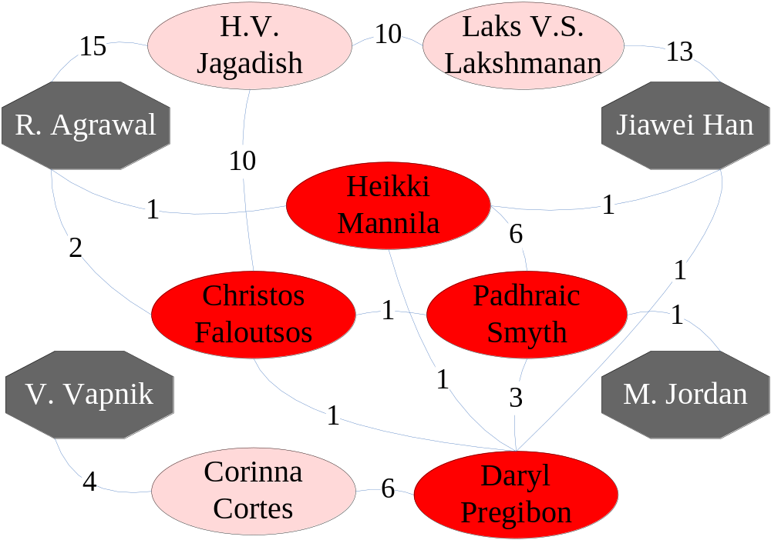
CePS: Example

Slide 20
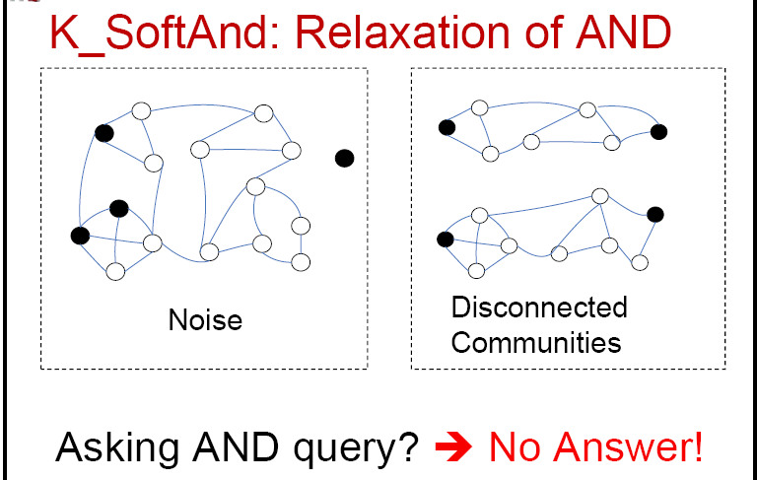

Slide 21
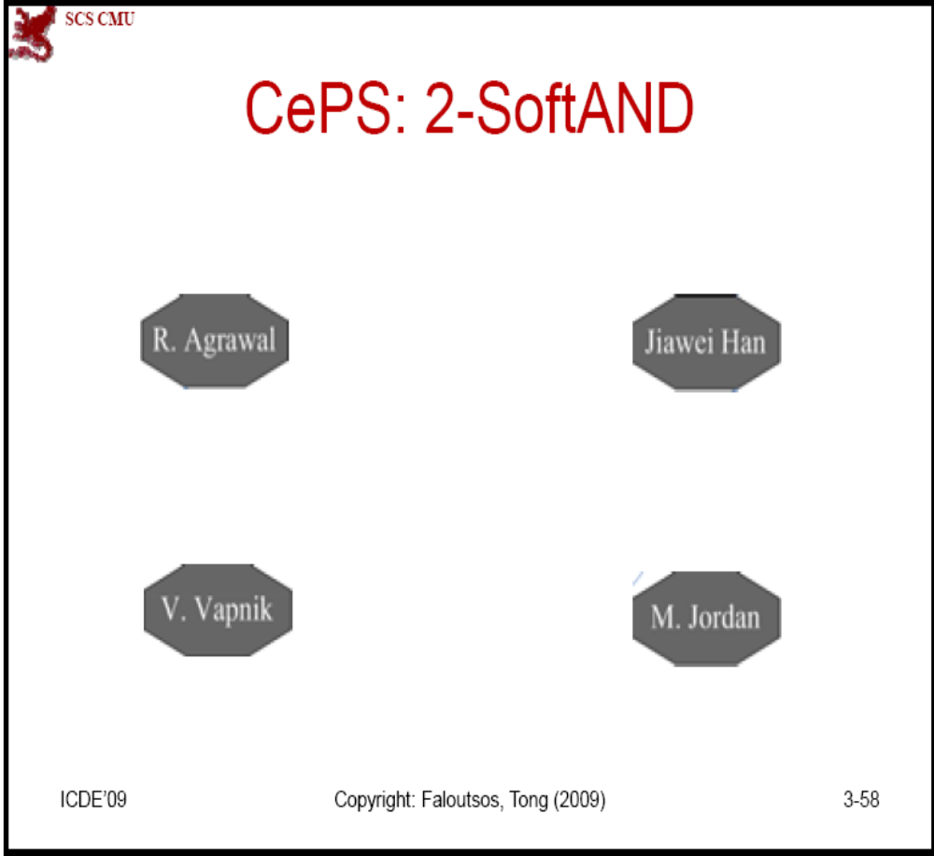

Slide 22
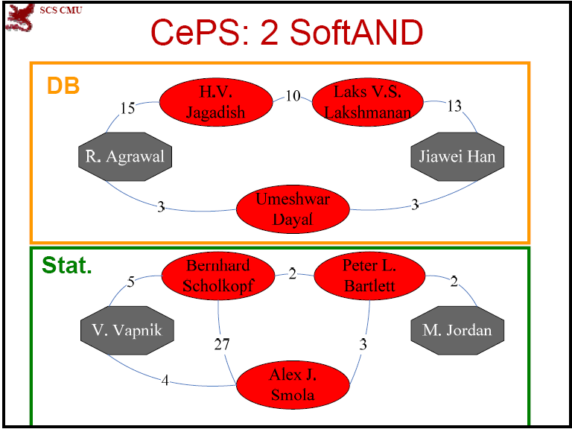

Slide 23
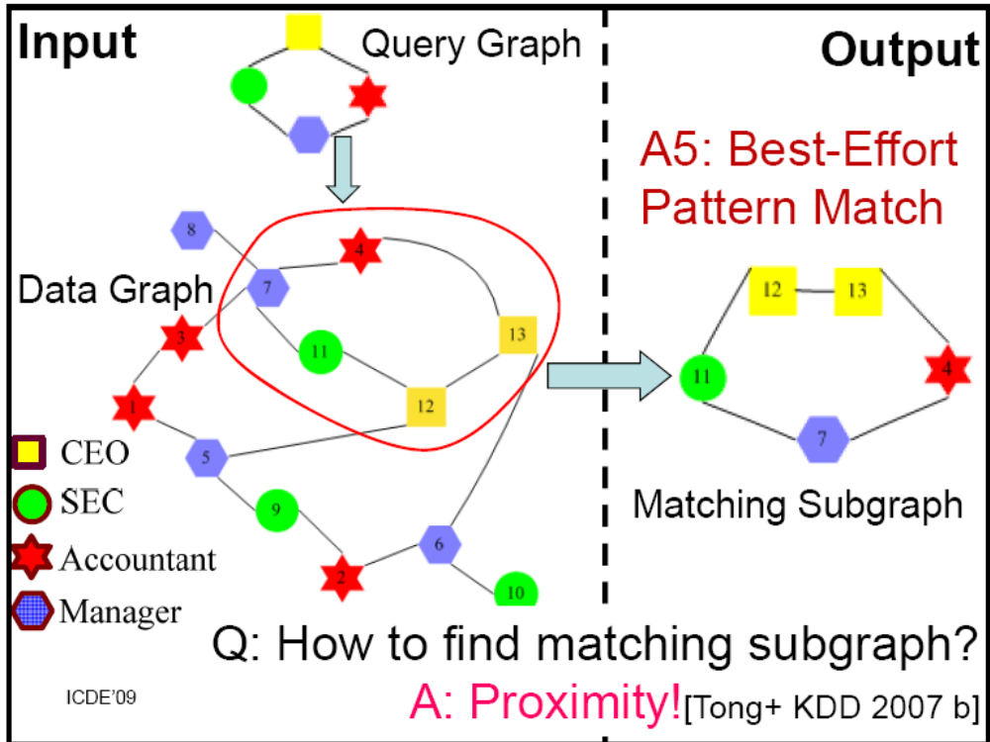

Slide 24
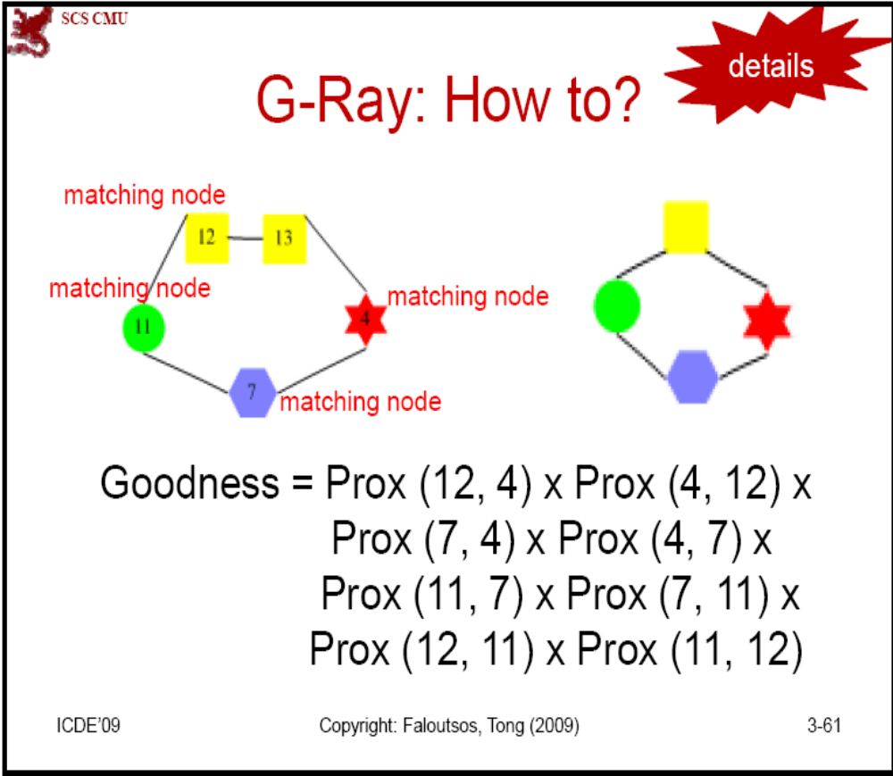

Slide 25
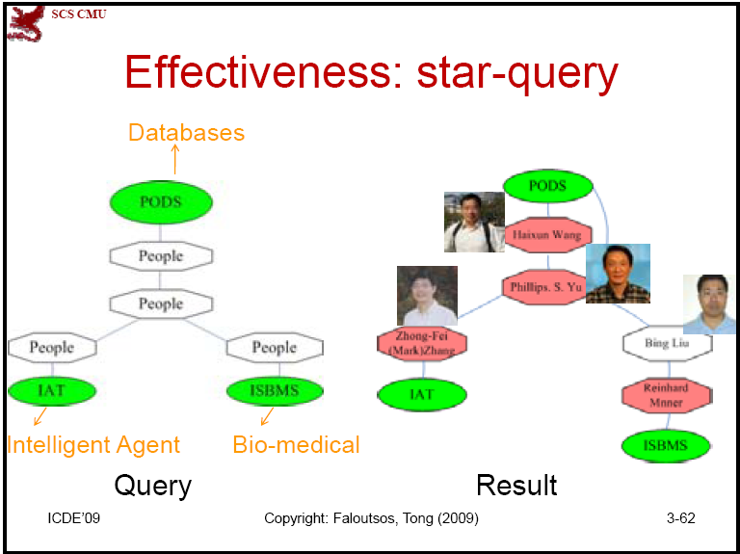

Slide 26
Frequent Graph Pattern Mining
Frequent subgraphs
  A (sub)graph is frequent if its support in a given dataset is no less than a minimum support threshold
Applications
  Mining biochemical structures
  Mining XML structures or Web communities
  Trees, lattices, sequences, and items are degenerated graphs

Slide 27
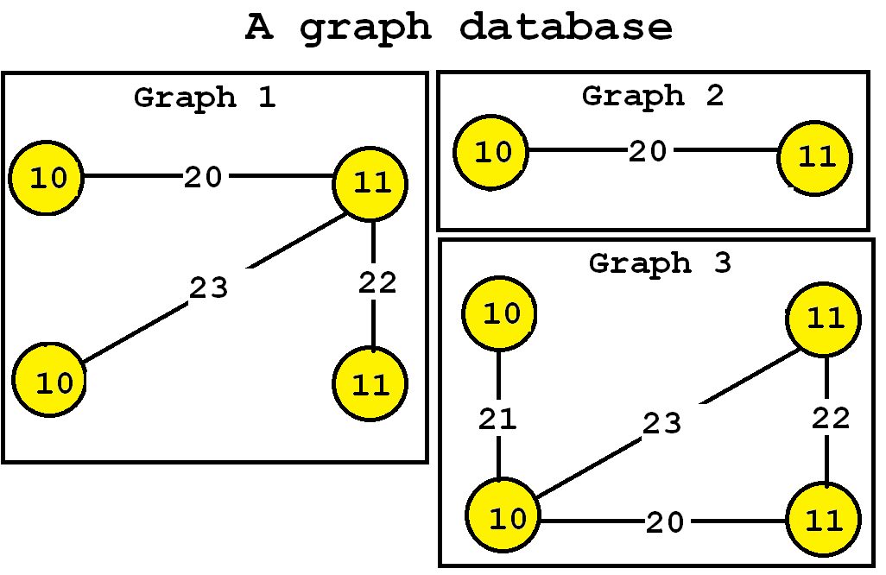
Frequent subgraph mining
Input:
a graph database (a set of graphs)
a minimum support threshold (minsup).
Example:
minsup = 3

Slide 28
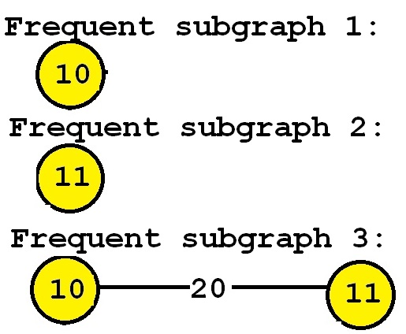
Output:
all subgraphs appearing in a least minsup graphs.
minsup = 3

Slide 29
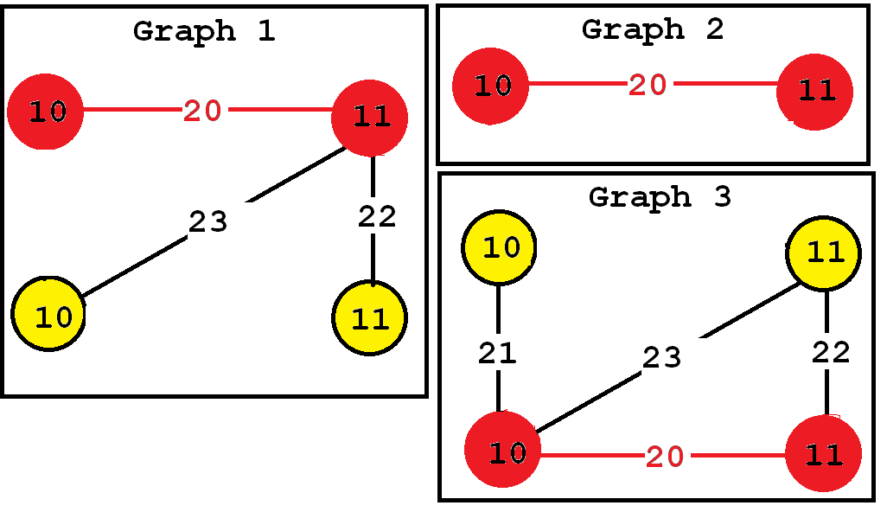
Output:
all subgraphs appearing in a least minsup graphs.
minsup = 3
This subgraph has a support of 3

Slide 30
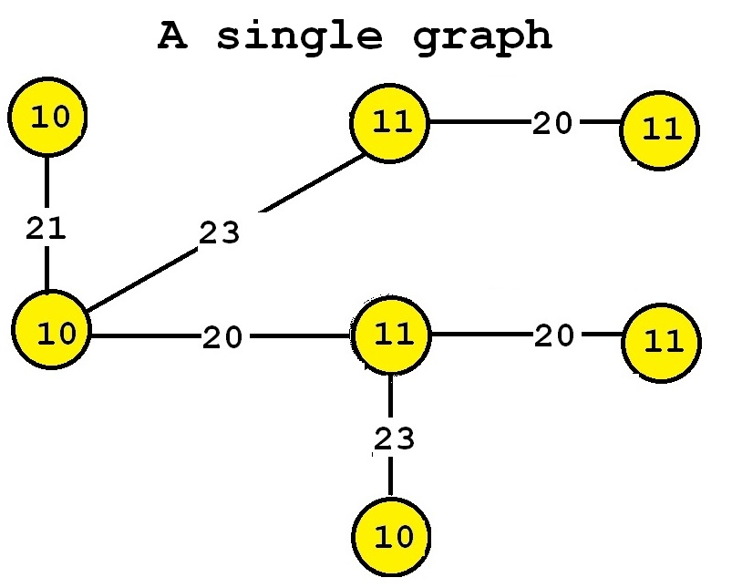
Frequent subgraph mining with a single graph
A variation of the previous problem.
We want to find frequent subgraphs in a single large graph.
The support of a subgraph is the number of times that it appears in the single input graph

Slide 31
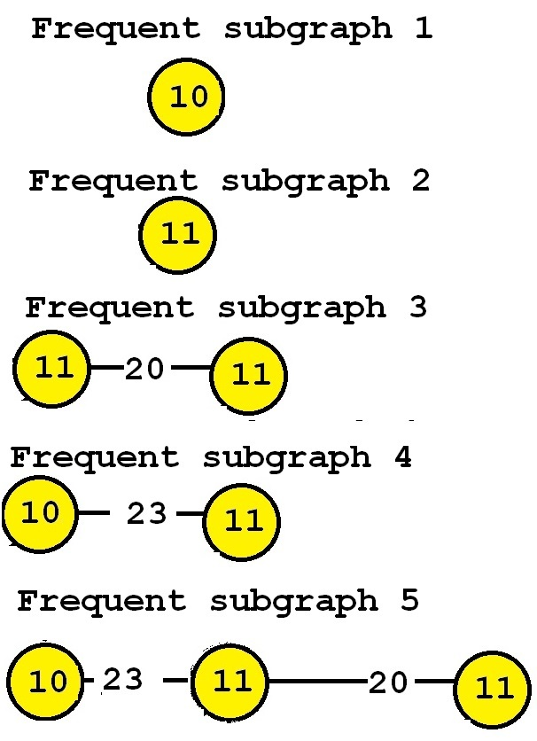
Frequent subgraph mining with a single graph
minsup = 2

Slide 32
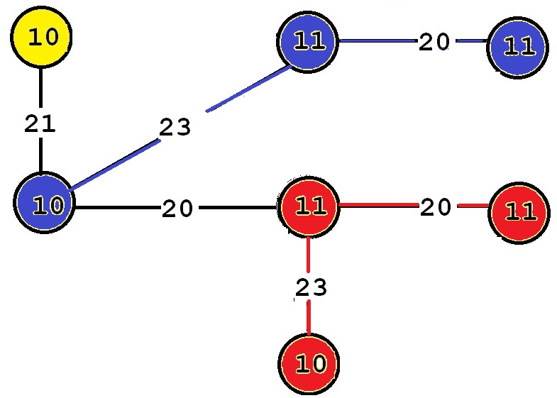
Frequent subgraph mining with a single graph
minsup = 2
This subgraph has a support of 2

Slide 33
Observation
If a graph is frequent, all of its subgraphs are frequent ─ the Apriori property
If some of its subgraphs have the same support, it is unnecessary to output these subgraphs (closed graphs): This still ensures the mining result is complete—“lossless compression”

Slide 34
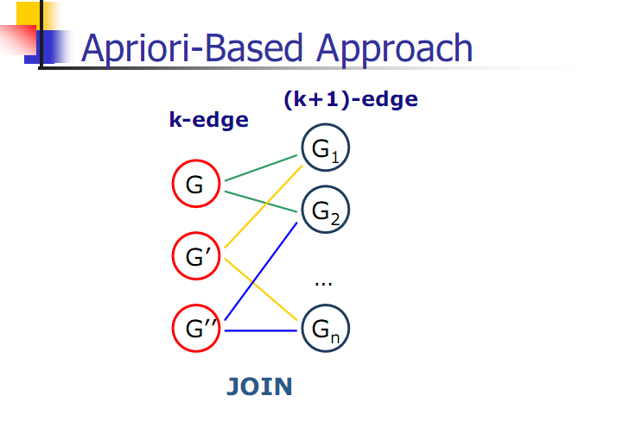

Slide 35

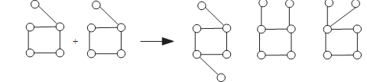
Apriori-based， BFS
Methodology：Breadth-search，joining two graphs
AGM（Inokuchi, et al. PKDD’00）,generates new graphs with one more node
FSG(Kuramochi and Karypis ICDM’01), generates new graphs with one more edge

Slide 36
So far, we covered
 | Read-based | Write-based | Point-based
Association Mining | Apriori[AgSr94] | FPGrowth [HaPe00]
Sub-Graph Mining | AGM[PKDD’00] FSG[ICDM’01] | Mofa[ICDM’02]
Sequential Pattern Discovery | GSP[AgSr96] | PrefixSpan [PHPC01]
Iceberg Cube | Apriori[AgSr94] |  | BUC[BeRa99], H-cubing [HPDW01]

